Slide 1

Consumer Shopping Trends: Insights into Purchase Behavior and Patterns
ITKM-548
Team-6:
Manoj Ravipati
Kiran Joshi
Yash A. Patel
Ajay Bhhanu Kanamarlapudi

Slide 2

Exploring the Kaggle Dataset-Customer Shopping (Latest Trends) Dataset
Comprehensive Coverage: captures important patterns and trends in consumer purchasing.
Transactional Data: Includes values and payment methods.
Customer Profiles: Features insights on age groups, gender, and locations.
Behavioral insights: Highlights purchase frequency, average transaction spend, and seasonal trends.
The goal is to understand customers better and uncover actionable retail information.

Slide 3
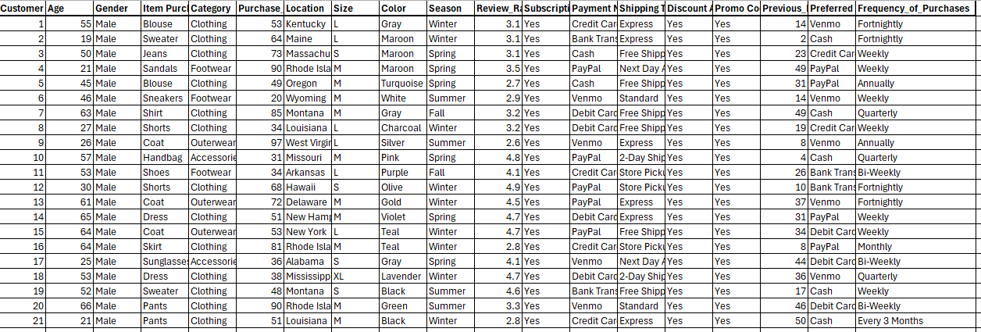
Data Overview
File Information:
Total Rows: 3,900
Total Columns: 19
Customer ID
Age
Gender
Item Purchased
Category
Purchase Amount (USD)
Location
Size
Season
Review Rating
Subscription Status
Payment Method
Preferred Payment Method

Slide 4
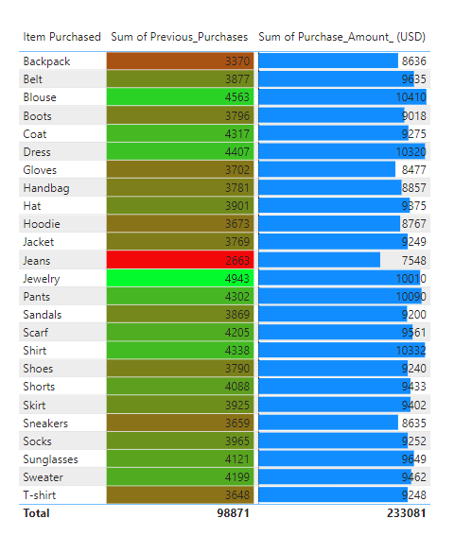
Conditional Formatting
Sum of Previous Purchase:
Background conditional format is applied.
Sum of Purchase Amount:
Data Bar conditional format is applied.

Slide 5
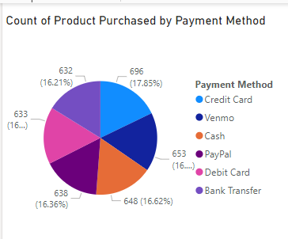
Pie Chart
The chart displays consumer shopping trends, including the total count of products purchased and payment methods used.
The distribution of purchases across payment methods, with percentages ranging from approximately 16% to 18%.
The data emphasizes patterns in consumer preferences and payment behavior.

Slide 6
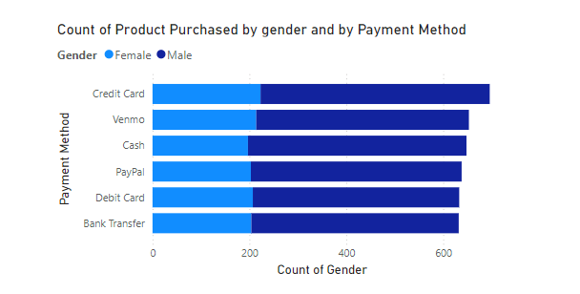
Stacked Bar Chart
The bar chart depicts the count of products purchased by gender and payment method.
Payment methods are represented, with separate bars for male and female consumers.
The data highlights a consistent purchasing trend among genders across most payment methods, with males slightly dominating purchases in most categories.
This visualization emphasizes the preferences and habits of different genders using specific payment methods.

Slide 7
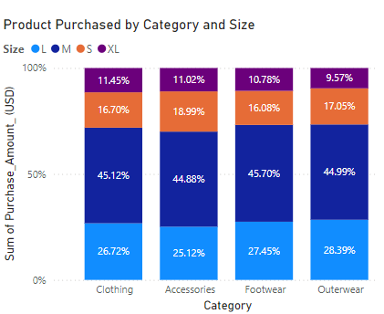
Stacked Column Chart
The stacked column chart displays the percentage distribution of products by category and Size.
Benefit to the company: Inventory Optimization
Targeted Marketing
Product Development
Customer Satisfaction
Provides a clear vision for effective decision-making

Slide 8
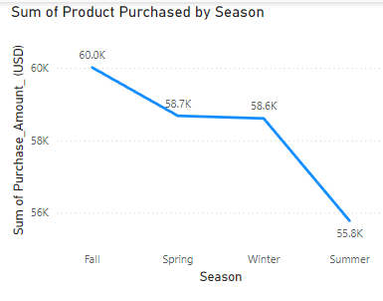
Line Chart
The Line chart displays the distribution of products by Season.
Benefit to Company:
Profit
Market Trend
Seasonal Development

Slide 9
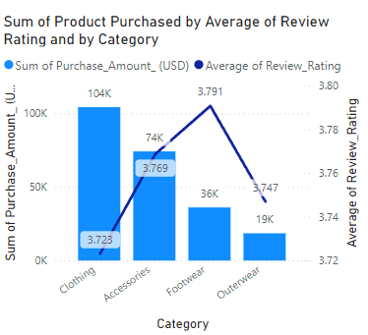
Line and Clustered Column Chart
Clothing leads in total purchase amount, surpassing $100K
Accessories are the second-highest category, with footwear and outerwear trailing behind.
The average review ratings vary by category, with accessories receiving the highest and outerwear the lowest ratings.

Slide 10
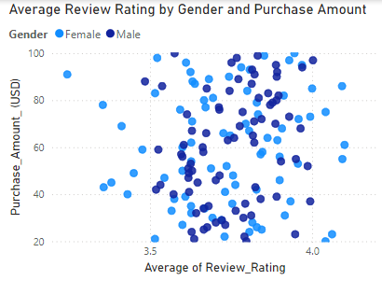
Scatter Chart
The scatter plot illustrates review ratings and purchase amounts segmented by gender.
Customer review ratings mostly fall between 3.6 and 3.9 for both genders.
Purchase amounts range from $20 to $100, showing no significant pattern related to gender differences.

Slide 11
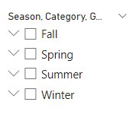
Slicer
A slicer is available to filter data by season, with options for Fall, Spring, Summer, and Winter.
A slicer is also available to filter data by Category.
A slicer is also available to filter data by Gender.

Slide 12
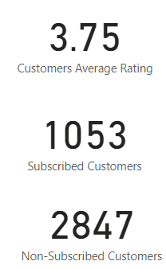
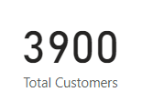
Cards
The total customer base is highlighted as 3,900, giving a clear view of the audience size.
The average customer rating is 3.75, showcasing overall satisfaction levels.
Out of the total customers, 1,053 are subscribed, while 2,847 are non-subscribed.

Slide 13
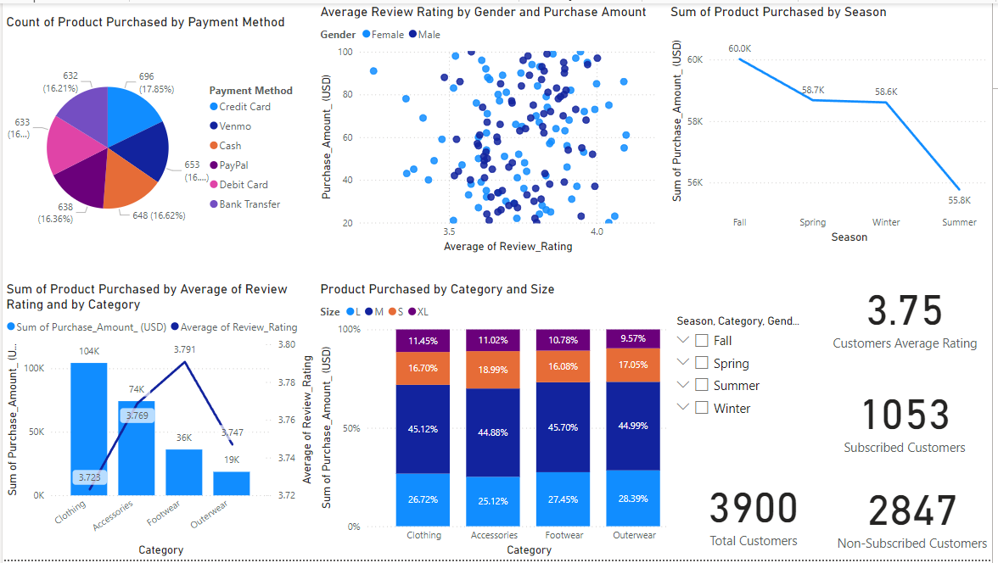
Sales Dashboard

Slide 14
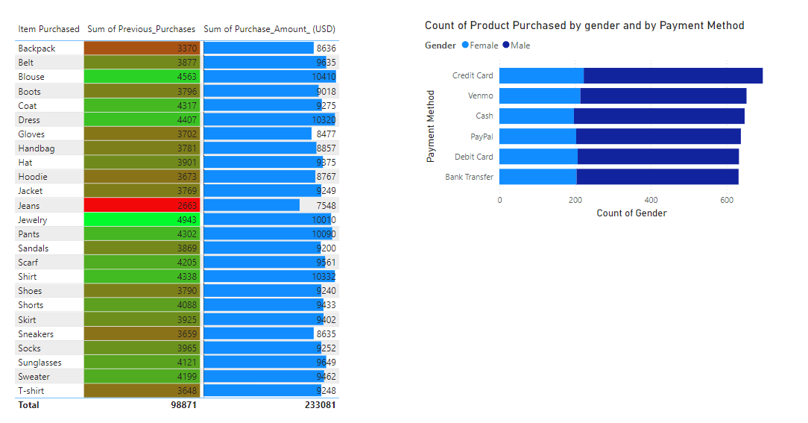
Sales Dashboard

Slide 15

Conclusion
Provides an understanding of modern consumer behavior and evolving market trends.
Businesses must prioritize customer response.
Gaining a competitive edge requires investments in digital infrastructure, sustainability initiatives, and personalization technology.

Slide 16
Source
Kaggle: https://www.kaggle.com/datasets/bhadramohit/customer-shopping-latest-trends-dataset/data

Slide 17

Questions…?

Slide 18

Thank you

